Slide 1
An Efficient Approach for Cross-Silo Federated Learning to Rank
Yansheng Wang, Yongxin Tong, Dingyuan Shi, Ke Xu School of Computer Science and Engineering Beihang University

Slide 2
Outline
Background and Motivation
Problem Statement
Our Solutions
Experiments
Conclusion

Slide 3
Outline
Background and Motivation
Problem Statement
Our Solutions
Experiments
Conclusion

Slide 4
Background
Data Isolation Problem in Artificial Intelligence
Where are the data?
different banks
different mobile users
Can we aggregate
all the data
together directly?
Fraud detection
User profiling
different platforms
different hospitals
Smart transportation
Wise medical
Data isolation problem is common for AI applications

Slide 5
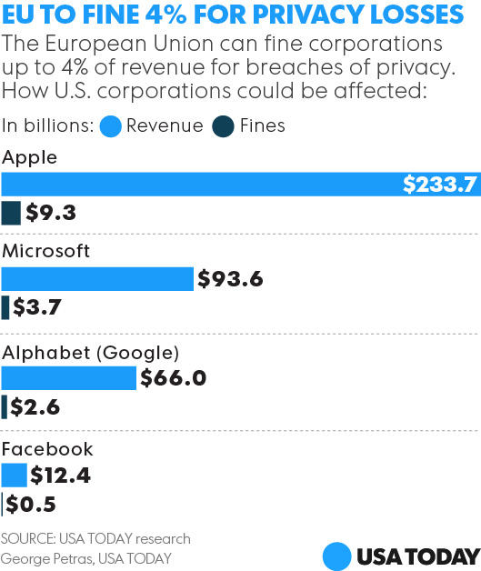
Background
Privacy laws and regulations
Stricter Privacy regulations
Large companies in lawsuits
Draft:2016
Start:2018
Stricter privacy laws exacerbate data isolation

Slide 6
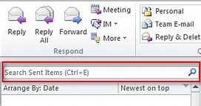
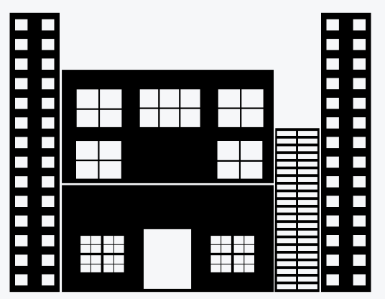
Background
Data isolation in information retrieval
Retrieval demands in data silos
Learning-to-rank (LTR)
How to obtain
quality services
Small hospitals
Medical record search
Small companies
E-mail search
Rank the documents by relevance to queries
Privacy concerns prohibit data sharing
training
Massive data
How can we break the barriers between data silos
to train effective LTR models?

Slide 7
Background
Federated learning (FL): break the barriers
Processed intermediate results can be shared
Model serving
Encryption
OR
Federated Model
Perturbation
$$D_{1}$$
$$D_{2}$$
…
$$D_{i}$$
…
$$D_{n}$$
Silo 1
Silo 2
Silo $i$
Silo $n$
Local data should not be aggregated
FL unites small data silos to collaboratively train models with high security and efficiency
B. McMahan et al, Communication-efficient learning of deep networks from decentralized data. In AISTATS 2016.
Q. Yang et al, Federated machine learning: Concept and applications. In TIST 2019.

Slide 8
Motivation
Can we apply existing FL to LTR directly?
Existing data partition settings
Raw data
instances
Silo 1
$$X$$
$$y$$
One silo can generate its own features/labels
$$X$$
$$y$$
…
Features
Fetures
Labels
instances
instances
Silo n
Silo 1
Silo 2
Silo n
Raw data
Horizontal partition
Vertical Partition
Data partition in federated LTR
relevence score
Raw data: documents and queries
TF,IDF,etc.
$$X′$$
$$y′$$
Server
Model
$$X′$$
$$y′$$
Features/labels need to be generated by
two silos
$$D_{1}$$
$$D_{2}$$
$$Q_{n}$$
$$X$$
$$y$$
…
Silo 1
$$Q_{1}$$
Silo 2
$$Q_{2}$$
Silo n
$$D_{n}$$
Federated LTR brings a new setting: cross partition

Slide 9
Motivation
Objective of our work
Document side
Query side
“what is a database?”
<TF,IDF,…>
Relevance
Preserve mutual privacy when generating the features/labels
$$X′$$
$$y′$$
Server
Model
$$X′$$
$$y′$$
Improve the efficiency
$$D_{1}$$
$$D_{2}$$
$$Q_{n}$$
$$X$$
$$y$$
…
Silo 1
$$Q_{1}$$
Silo 2
$$Q_{2}$$
Silo n
$$D_{n}$$
Objective: a privacy-preserving and efficient framework

Slide 10
Contribution
Formally define the unique federated LTR problem with cross-partitioned data
Propose a sketch and DP based framework with privacy and utility guarantees
Optimize the framework with an efficient structure
Make extensive experiments on public data

Slide 11
Outline
Background and Motivation
Problem Statement
Our Solutions
Experiments
Conclusion

Slide 12
Problem Statement
Federated LTR problem
Document side
Query side
“what is a database?”
Key step:
Data generation
<TF,IDF,…>
Relevance
Augmented data
$$X′$$
$$y′$$
Server
Model
$$X′$$
$$y′$$
Set of documents
$$D_{1}$$
$$D_{2}$$
$$Q_{n}$$
$$X$$
$$y$$
…
Local data
Silo 1
$$Q_{1}$$
Silo 2
$$Q_{2}$$
Silo n
$$D_{n}$$
Set of queries
n silos

Slide 13
Problem Statement
Basic operators in feature generation
Document side
Query side
“what is a database?”
Key step:
Data generation
<TF,IDF,…>
Relevance
$$TF_{i,j}\left(t_{k}, d\right)=\frac{TC_{i,j}(t_{k}, d)}{l_{d}}$$
term count of $t_{k}$ in $d$ : private
Cross party TF:
document length
$$IDF_{i}\left(t_{k}\right)=log\frac{\sum_{j=1}^{n}{{|D}_{j}|}}{\sum_{j=1}^{n}{\sum_{d∈D_{j}}{𝕀(TF_{i,j}\left(t_{k}, d\right)>0)}}}$$
Privacy should be preserved in both side
Cross party IDF:
$${BM25}_{i,j}\left(q, d\right)=\sum_{k=1}^{M}{\frac{IDF_{i}\left(t_{k}\right)∙TF_{i,j}\left(t_{k}, d\right)∙(k_{1}+1)}{TF_{i,j}\left(t_{k}, d\right)+k_{1}}}$$
Cross party BM25:
LMIR, … : can also be represented by TF

Slide 14
Problem Statement
Reverse top-K document query
Document side
Query side
“what is a database?”
Key step:
Data generation
<TF,IDF,…>
Relevance
Positive instances are much more meaningful
TC-based metric
f(t)=5
Reverse top K=2 relevant docs
f(t)=4
(<5>,1), (<4>,1)
f(t)=3
“what is a database?”
2 positive instances
Naïve solutions can be very low in efficiency
A querying term t
f(t)=2

Slide 15
Outline
Background and Motivation
Problem Statement
Our Solutions
Experiments
Conclusion

Slide 16
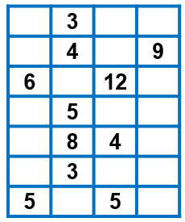
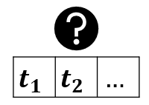
Our solution
Privacy-preserving cross-party TF query
Sketch
construction
Server
$$X′$$
$$y′$$
$$X′$$
$$y′$$
Hashing with obfuscation
…
Silo 1
Silo 2
Silo n
$$D_{1}$$
$$Q_{1}$$
$$D_{2}$$
$$Q_{2}$$
$$D_{n}$$
$$Q_{n}$$
Result
perturbation

Slide 17
Our solution
Privacy-preserving cross-party TF query
Sketch
construction
Server
$$X′$$
$$y′$$
$$X′$$
$$y′$$
Hashing with obfuscation
…
Silo 1
Silo 2
Silo n
$$D_{1}$$
$$Q_{1}$$
$$D_{2}$$
$$Q_{2}$$
$$D_{n}$$
$$Q_{n}$$
Result
perturbation
+
result=5

Slide 18
Our solution
Step 1: Sketch construction
Document side
Query side
terms
Doc
CM Sketch
Query
$$t_{1}$$ | $$t_{2}$$ | $$…$$
$$t_{2}$$
$$i$$ | $$h_{i}(t_{2})$$
1 | 2
2 | 4
3 | 3
4 | 2
5 | 3
6 | 2
7 | 1
Hashing value of
hash function #1

Slide 19
Our solution
Step 1: Sketch construction
Document side
Query side
Doc
CM Sketch
Query
$$t_{1}$$ | $$t_{2}$$ | $$…$$
 | +1
 |  |  | +1
 |  | +1
 | +1
 |  | +1
 | +1
+1
$$t_{2}$$
$$i$$ | $$h_{i}(t_{2})$$
1 | 2
2 | 4
3 | 3
4 | 2
5 | 3
6 | 2
7 | 1
Updating corresponding positions

Slide 20
Our solution
Step 2: Hashing with obfuscation
Document side
Query side
2
2
1
2
2
2
3
2
4
3
2
3
2
1
Doc
CM Sketch
Query
 | 3
 | 4 |  | 9
6 |  | 12
 | 5
 | 8 | 4
 | 3
5 |  | 5
look-up
obfuscation
hashing
$$t_{1}$$ | $$t_{2}$$ | $$…$$
$$t_{2}$$
$$i$$ | $$h_{i}(t_{2})$$
1 | 2
2 | 4
3 | 3
4 | 2
5 | 3
6 | 2
7 | 1

Slide 21
Our solution
Step 3: Result perturbation
Document side
Query side
2
2
1
2
2
2
3
2
4
3
2
3
2
1
Doc
CM Sketch
Query
 | 3
 | 4 |  | 9
6 |  | 12
 | 5
 | 8 | 4
 | 3
5 |  | 5
look-up
obfuscation
hashing
$$t_{1}$$ | $$t_{2}$$ | $$…$$
$$t_{2}$$
$$i$$ | $$h_{i}(t_{2})$$
1 | 2
2 | 4
3 | 3
4 | 2
5 | 3
6 | 2
7 | 1
3
4
6
5
8
3
5
4
4
7
4
9
4
4
Min
4
Noise
injection

Slide 22
Our solution
Step 3: Result perturbation
Preserve privacy of querying terms
Document side
Query side
2
2
1
2
2
2
3
2
4
3
2
3
2
1
Doc
CM Sketch
Query
 | 3
 | 4 |  | 9
6 |  | 12
 | 5
 | 8 | 4
 | 3
5 |  | 5
look-up
obfuscation
hashing
$$t_{1}$$ | $$t_{2}$$ | $$…$$
$$t_{2}$$
$$i$$ | $$h_{i}(t_{2})$$
1 | 2
2 | 4
3 | 3
4 | 2
5 | 3
6 | 2
7 | 1
3
4
6
5
8
3
5
4
4
7
4
9
4
4
Min
4
Noise
injection
Preserve privacy of documents

Slide 23
Our solution
Step 3: Result perturbation
Preserve privacy of querying terms
Document side
Query side
2
2
1
2
2
2
3
2
4
3
2
3
2
1
Doc
CM Sketch
Query
 | 3
 | 4 |  | 9
6 |  | 12
 | 5
 | 8 | 4
 | 3
5 |  | 5
look-up
obfuscation
hashing
$$t_{1}$$ | $$t_{2}$$ | $$…$$
$$t_{2}$$
Accuracy loss:
$$Pr\left[\left|{\hat{f}}_{t}−f_{t}\right|≤\sqrt{\frac{16}{ε^{2}}+\frac{64}{w}∙F_{2}^{Res}}\right]≥1−δ$$
$$i$$ | $$h_{i}(t_{2})$$
1 | 2
2 | 4
3 | 3
4 | 2
5 | 3
6 | 2
7 | 1
3
4
6
5
8
3
5
4
4
7
4
9
4
4
Min
4
Noise
injection
Satisfy $ε−DP$
Preserve privacy of documents

Slide 24
Our solution
Efficient reverse top-K document query
Naïve solution
Server
$$X′$$
$$y′$$
$$X′$$
$$y′$$
…
Silo 1
Silo 2
Silo n
$$X′$$
$$y′$$
$$D_{1}$$
$$Q_{1}$$
$$D_{2}$$
$$Q_{2}$$
$$D_{n}$$
$$Q_{n}$$
generate
irrelevant
relevant
irrelevant
O(# of docs $∙$ # of queries)
for only 2 silos

Slide 25
Our solution
Efficient reverse top-K document query
Reverse top-K (RTK) sketch
O(# of docs)
O(K)

Slide 26
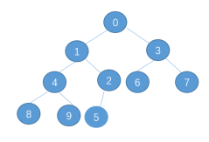
Our solution
Efficient reverse top-K document query
Reverse top-K (RTK) sketch
O(# of docs)
O(K)
Initialize
Silo 1
RTK Sketch
$$D_{1}$$
z
w
<key1, value1>
<key2, value2>
…
Size=$αK$
Min-Heap

Slide 27
Our solution
Efficient reverse top-K document query
Reverse top-K (RTK) sketch
O(# of docs)
O(K)
Initialize
Silo 1
RTK Sketch
$$D_{1}$$
Update
<key=doc id,value =
z
Update in each Min-Heap
w
$$O(wz logαK)$$

Slide 28
Our solution
Efficient reverse top-K document query
Reverse top-K (RTK) sketch
O(# of docs)
O(K)
Initialize
Silo 1
RTK Sketch
$$D_{1}$$
Update
Delete
z
w
Delete every node with “doc id”
$$O(wzαK)$$

Slide 29
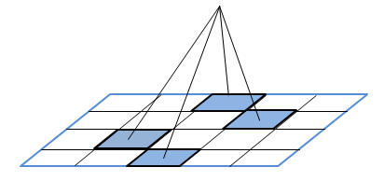
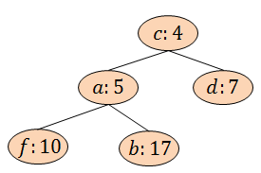
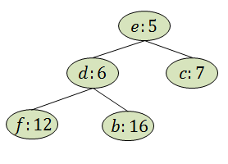
Our solution
Efficient reverse top-K document query
Reverse top-K (RTK) sketch
O(# of docs)
O(K)
$$Q_{2}$$
Initialize
Silo 2
Silo 1
query term t
$$D_{1}$$
RTK Sketch
hashing
Update
<doc id, count>
Delete
soft intersection
Query
min
Approximation guarantee:
$E\left[\hat{K}\right]/K$ is a constant
$$X′$$
$$y′$$
Top-K
doc ‘b’
K=2
doc ‘f’
$$X′$$
$$y′$$

Slide 30
Our solution
Learning process
Server
Model
gradient descent
$$∇f_{1}^{t}$$
…
$$w_{}^{t}$$
Silo 1
Silo i
Silo n
$$D_{1}$$
$$Q_{1}$$
$$D_{2}$$
$$Q_{2}$$
$$D_{n}$$
$$Q_{n}$$
Local data
$$X_{1}$$
$$y_{1}$$
$$X_{i}$$
$$y_{i}$$
$$X_{n}$$
$$y_{n}$$
Augmented
data
$$X_{1}′$$
$$y_{1}′$$
$$X_{i}′$$
$$y_{i}′$$
$$X_{n}′$$
$$y_{n}′$$

Slide 31
Outline
Background and Motivation
Problem Statement
Our Solutions
Experiments
Conclusion

Slide 32
Experiments
Dataset
MS MACRO
http://www.msmarco.org/dataset.aspx
Setting
4 data silos
Each has 200 queries and 36K documents
Each document has about 1K terms
Features: follow LETOR 4.0 (TF, IDF, TF-IDF, BM25, LMIR,…)
Labels: highly relevant (2), relevant (1), irrelevant (0)
Training set
4 * 28K (local data)
4 * 29K (augmented data)
Test set: 32K
Model: linear classification
Notes:
We use a synthetic dataset and a real dataset,…

Slide 33
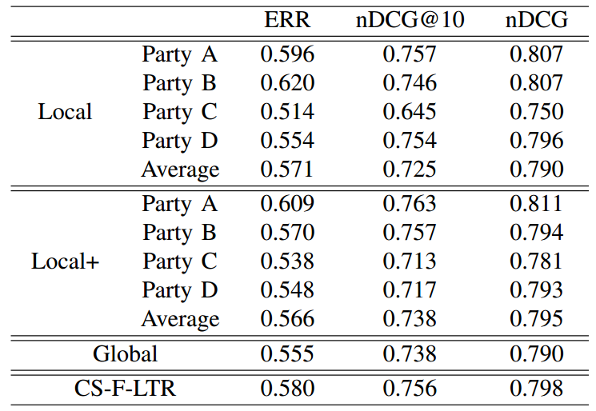
Experiments
Comparing methods
Local: local data only
Local+: local data + augmented data
Global: local data together
CS-F-LTR: local data + augmented data together
Evaluation metrics
ERR, nDCG@10, nDCG
FL does not benefit every party
Augmented data can bring much improvement
Notes:
We use a synthetic dataset and a real dataset,…

Slide 34
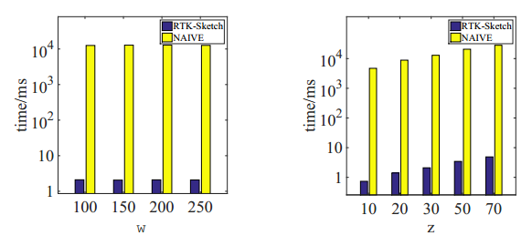
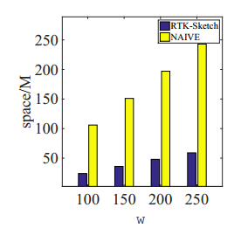
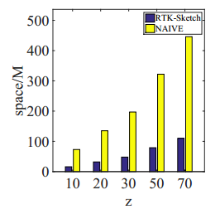
Experiments
Efficiency of RTK-Sketch
1000x speed-up in feature generation
Save over 80% memory cost
Notes:
We use a synthetic dataset and a real dataset,…

Slide 35
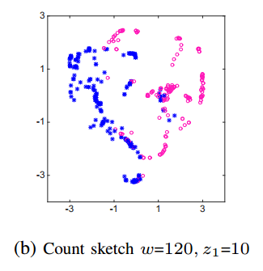
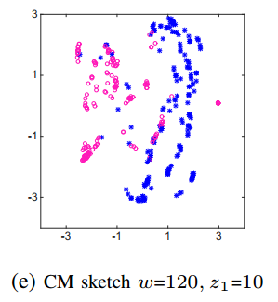
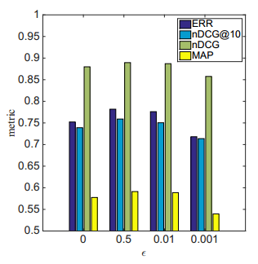
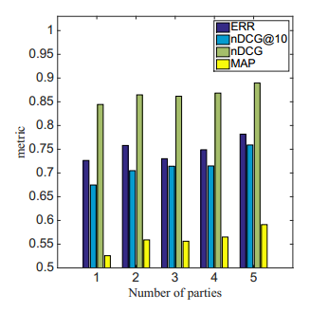
Experiments
Parameter study
Still distinguishable after sketching
Non-IID problem
Reasonable
Trade-off
Notes:
We use a synthetic dataset and a real dataset,…

Slide 36
Outline
Background and Motivation
Problem Statement
Our Solutions
Experiments
Conclusion
Notes:
Finally, we conclude our work

Slide 37
Conclusion
Propose the novel federated LTR problem with cross-partitioned data
Devise a sketch and DP based scheme to ensure private feature generation
Propose RTK-sketch to improve efficiency
Extensive experiments on real datasets show that our solution is both effective and efficient.

Slide 38
Thank You
Q & A

